Slide 1
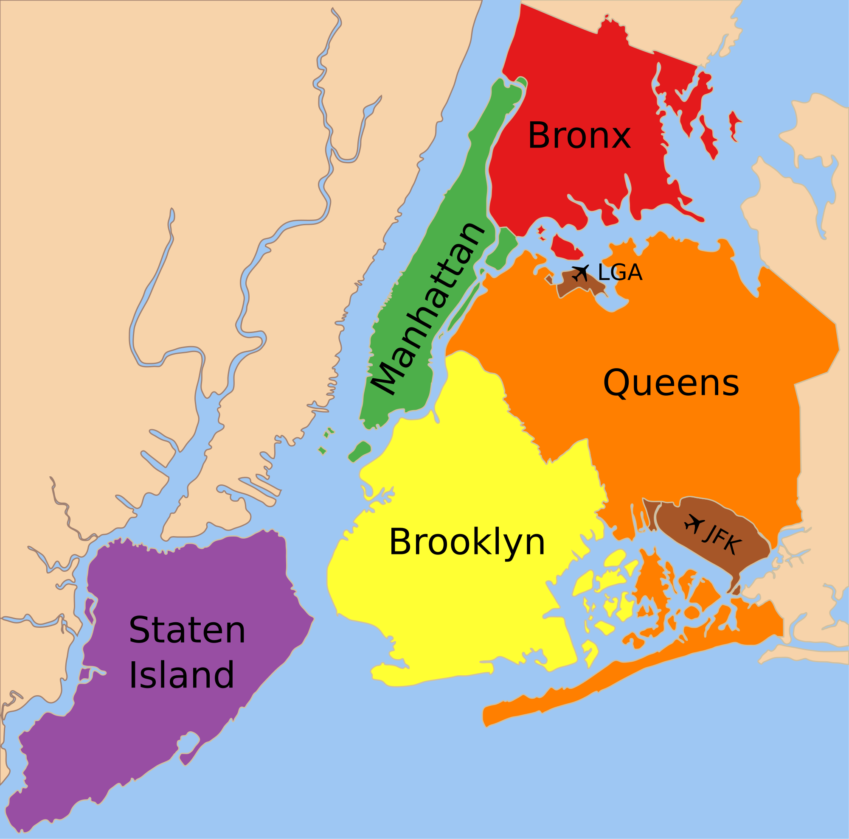
“The Battle
Of
Neighborhoods”
ABC Company Ltd.

Slide 2
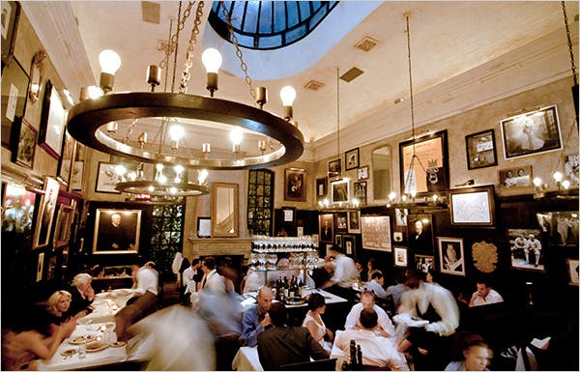
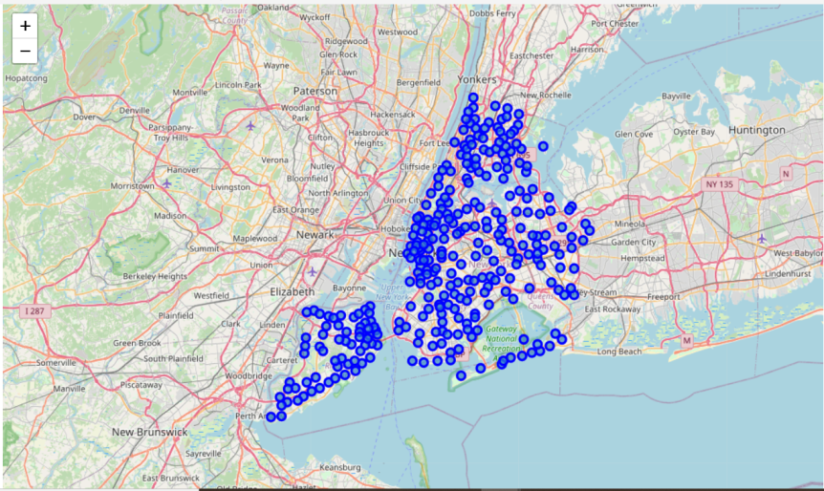
Introduction
New York city review for ABC company Ltd.
Optimum location for opening a restaurant.
Business Problem
Choice of first neighborhood to start restaurant business.
Easy to replicate.
Low competition
High demand
Choice of Menu

Slide 3
Factors to decide on the location to be choosen:
New York Population
New York Demographics
New York Boroughs and Neighborhoods
Markets nearby
Cuisine / Menu Severed

Slide 4
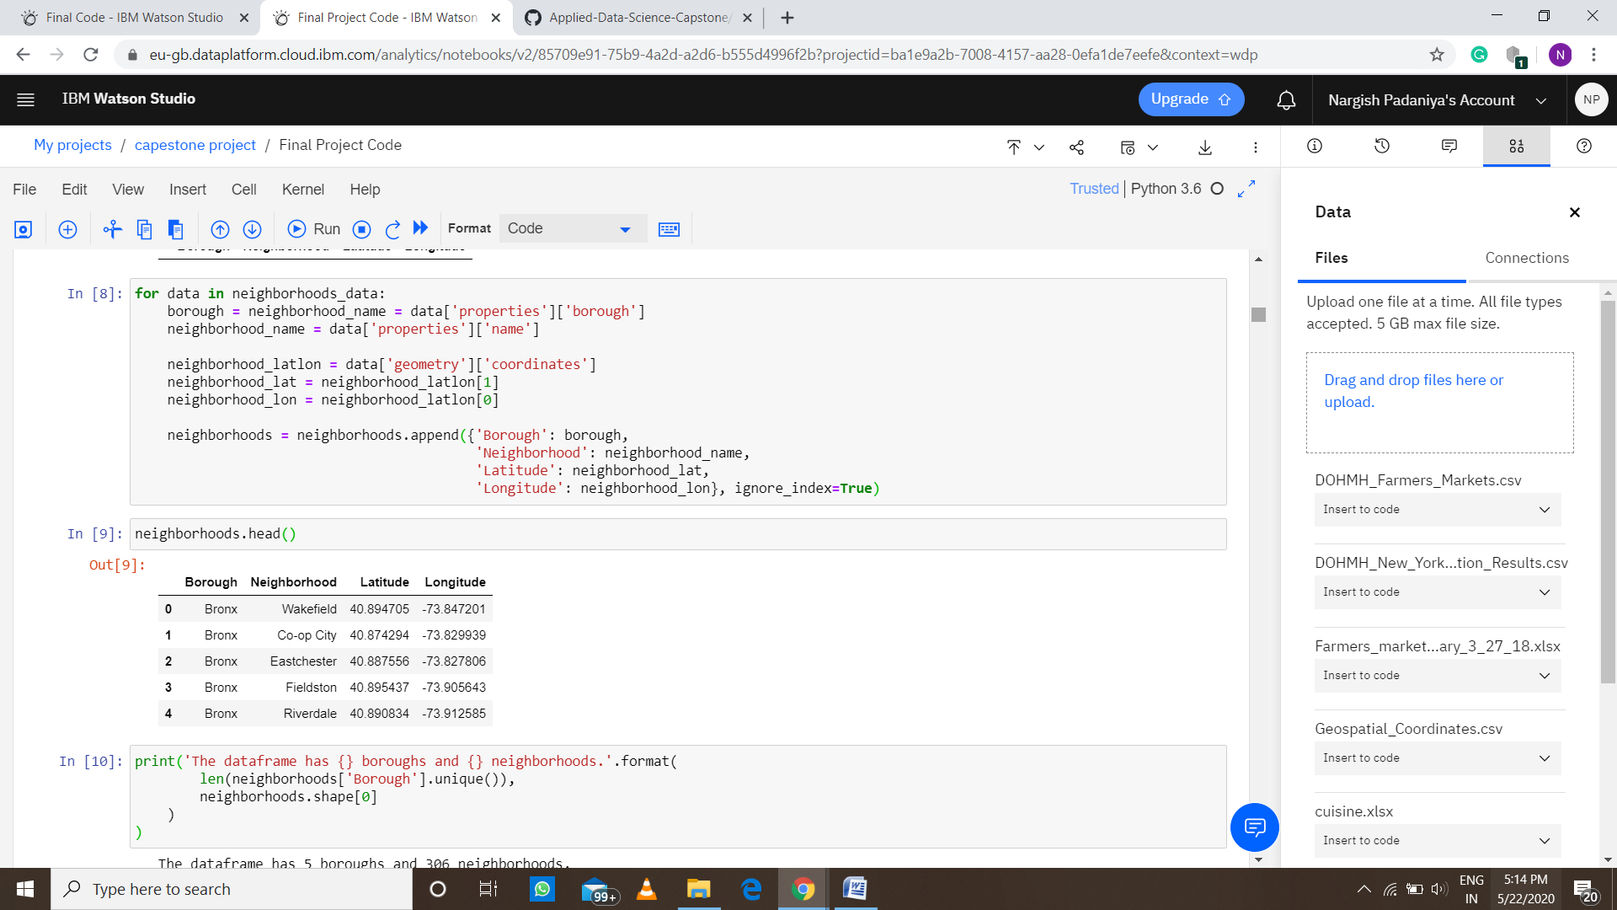
Data Discription
Data 1 : Neighborhood has a total of 5 boroughs and 306 neighborhoods. In
order to segment the neighborhoods and explore them, we will essentially
need a dataset that contains the 5 boroughs and the neighborhoods that
exist in each borough as well as the latitude and longitude coordinates of
each neighborhood.

Slide 5
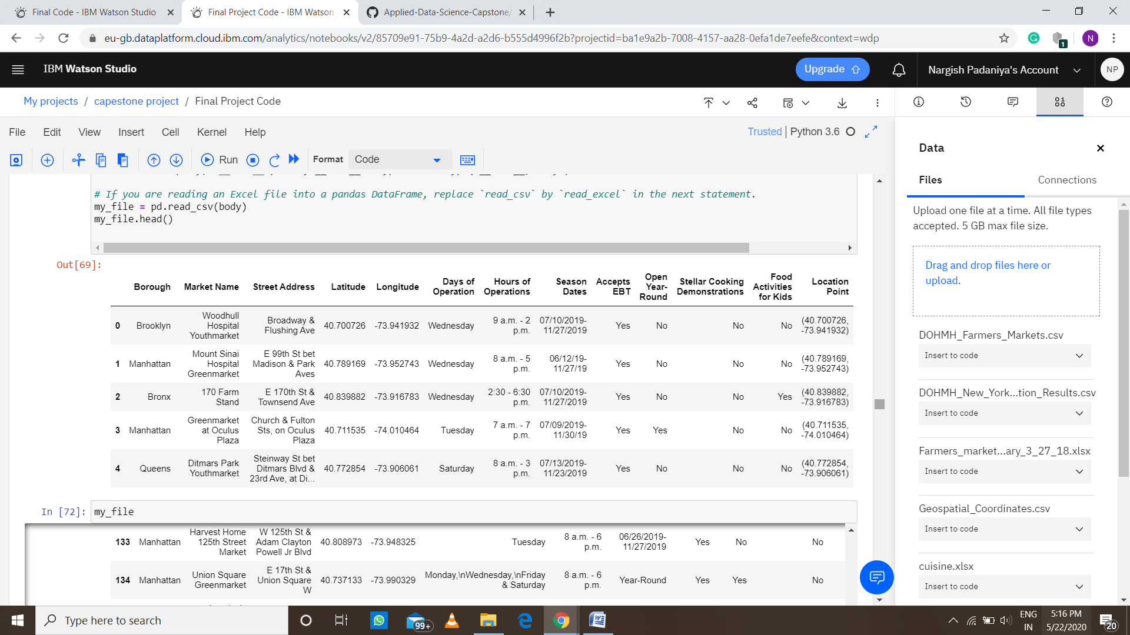
Data 2 : Farmers Markets data –
A farmers' market is often defined as a public site used by two or more local or regional producers for the direct sale of farm products to consumers. In
addition to fresh fruits and vegetables, markets may sell dairy products, fish,
meat, baked goods, and other minimally processed foods.

Slide 6
Data 3 : Data from Wikipedia pages as given below :
• New York Population
• Cuisine of New York city
The data has been taken from the following links
https://en.wikipedia.org/wiki/New_York_City
https://en.wikipedia.org/wiki/Economy_of_New_York_City
https://en.wikipedia.org/wiki/Cuisine_of_New_York_City

Slide 7
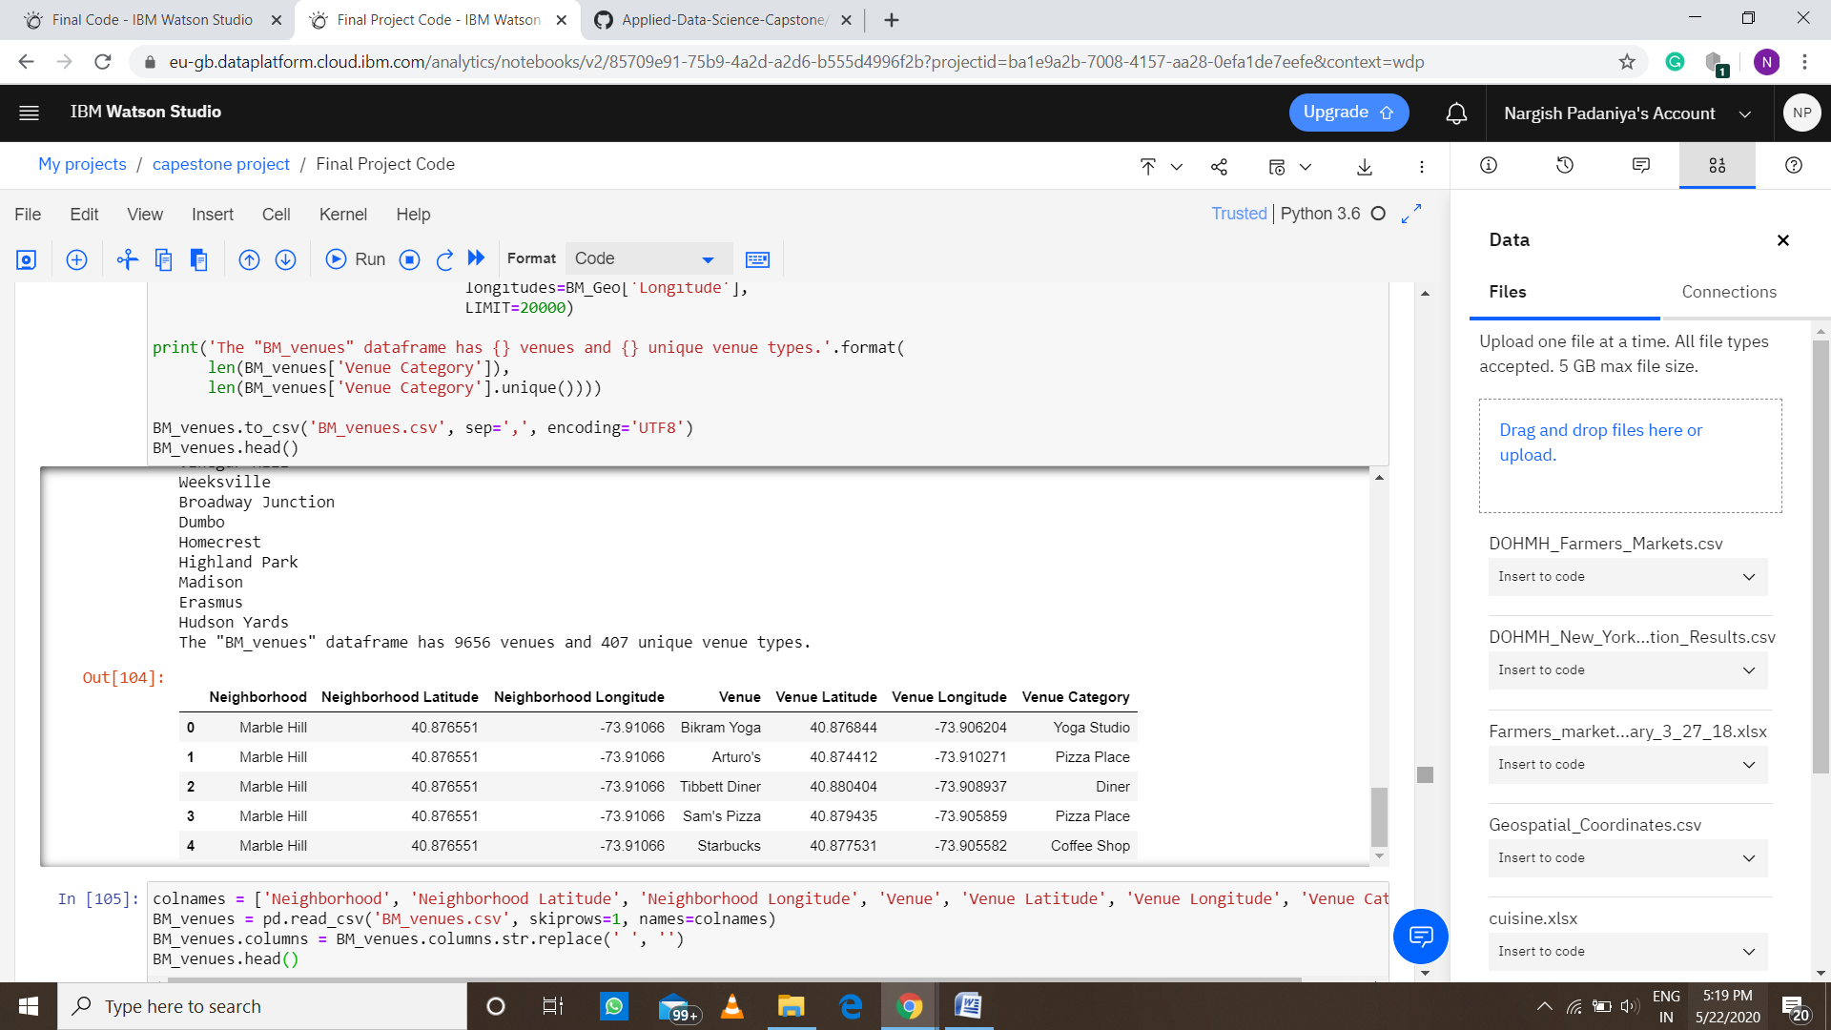
Data 4 : Data from foursquare.com
New York city geographical coordinates data will be utilized as input for the
Foursquare API, that will be leveraged to provision venues information for each
neighborhood. We will use the Foursquare API to explore neighborhoods in New York City. The below is image of the Foursquare API data.

Slide 8
Analytical Approach
New York city neighborhood has a total of 5 boroughs and
306 neighborhoods.
PART 1 - Clustering of Manhattan and Brooklyn
PART 2 - Clustering of Bronx, Queens and Staten Island
Only restaurant data is filtered from foursquare.com venues
data and utilized for this project.
This is done because of the following Exploratory data analysis.

Slide 9

Methodology
Data 1-New York city Geographical Coordinates Data
In this we load the data and explore data from newyork_data.json file.
Transform the data of nested python dictionaries into a pandas dataframe.
This dataframe contains the geographical coordinates of New York city neighborhoods.
This data will used to get venues data from foursquare.
We used geopy and folium libraries to create a map of New York city with neighborhoods superimposed on top.

Slide 10
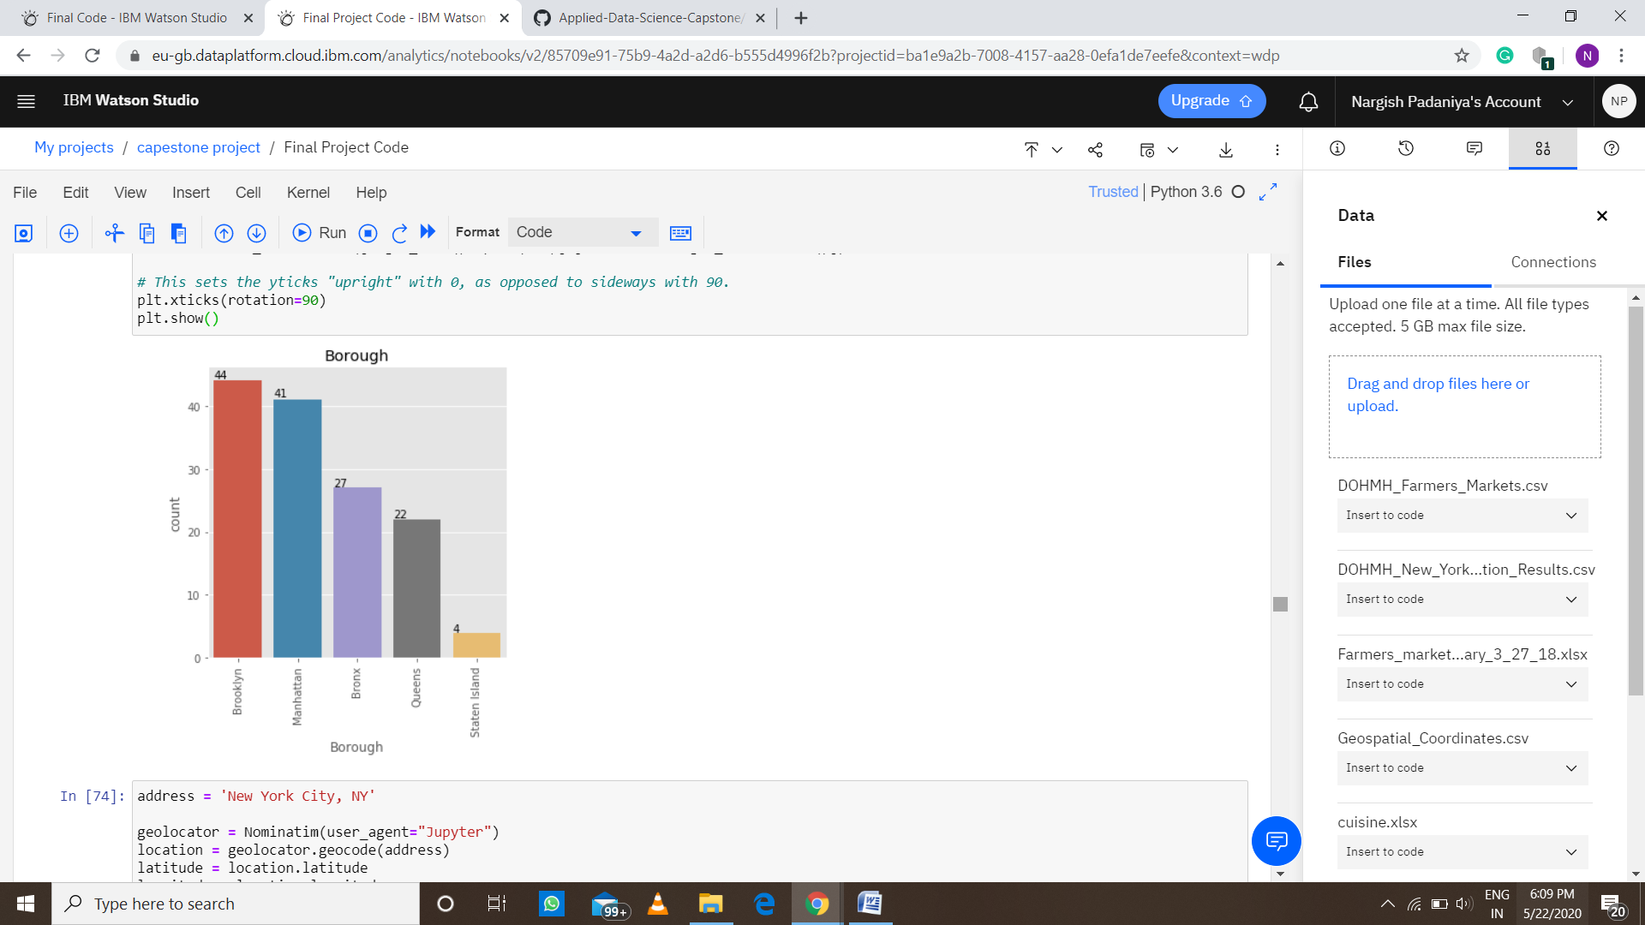
Data 2- DOHMH Farmers
Markets and Food Boxes
dataset.
In this we will be using the
data of Farmers Markets
There are totally 137
Farmers Markets in New York
city.
Highest number are in
Manhattan and Brooklyn.
And lowest in Queens, Bronx
and Staten Island.

Slide 11
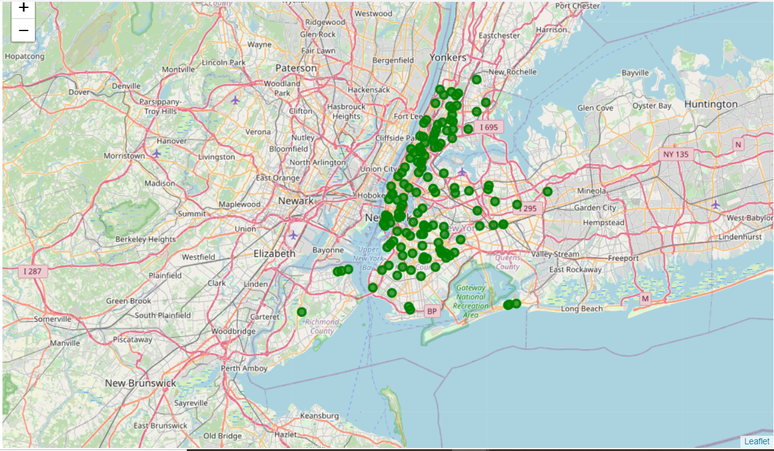
Farmers Market visualization-New York City. Using geopy function.

Slide 12
Data 3 : To analyize New York city Population, Demographics and Cuisine , scrapped the data from Wikipedia pages given above in the data section.
• We used BeautifulSoup python library.
• Beautiful Soup is a Python package for parsing HTML and XML documents (including having malformed markup, i.e. non-closed tags, so named after tag soup).
• It creates a parse tree for parsed pages that can be used to extract data from HTML, which is useful for web scraping

Slide 13
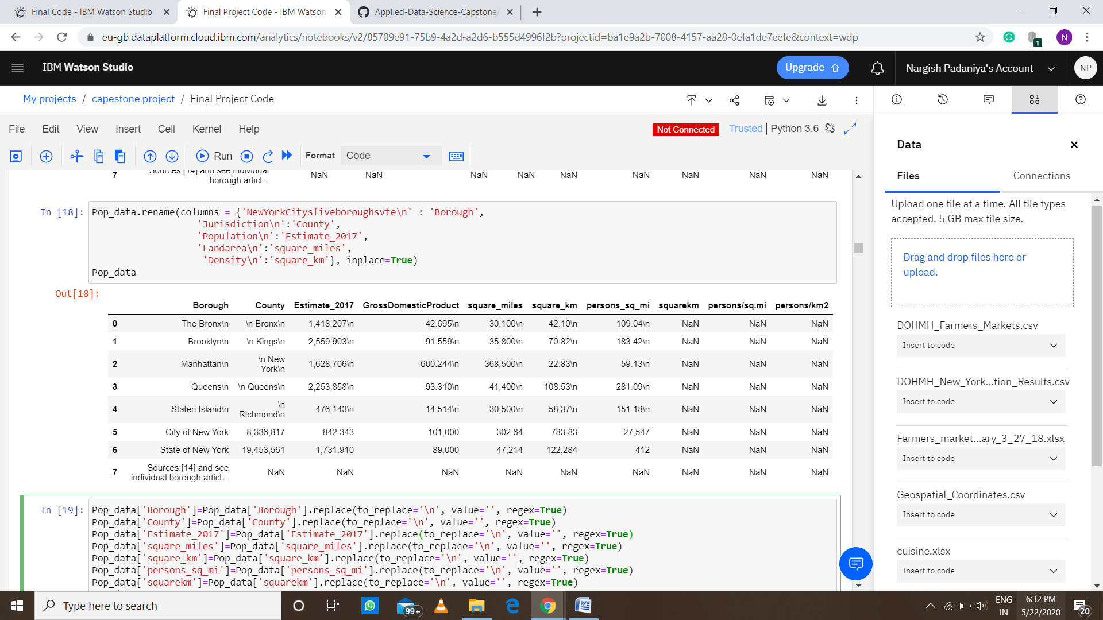
New York Population
Manhattan (New York County) is the geographically smallest and most densely
populated borough.
• Manhattan's (New York County's) population density of 368,000 people per square mile and higher than the density of any individual American city.
• Brooklyn (Kings County), on the western tip of Long Island, is the city's most populous borough.
• Queens (Queens County), on Long Island north and east of Brooklyn, is
geographically the largest borough.

Slide 14
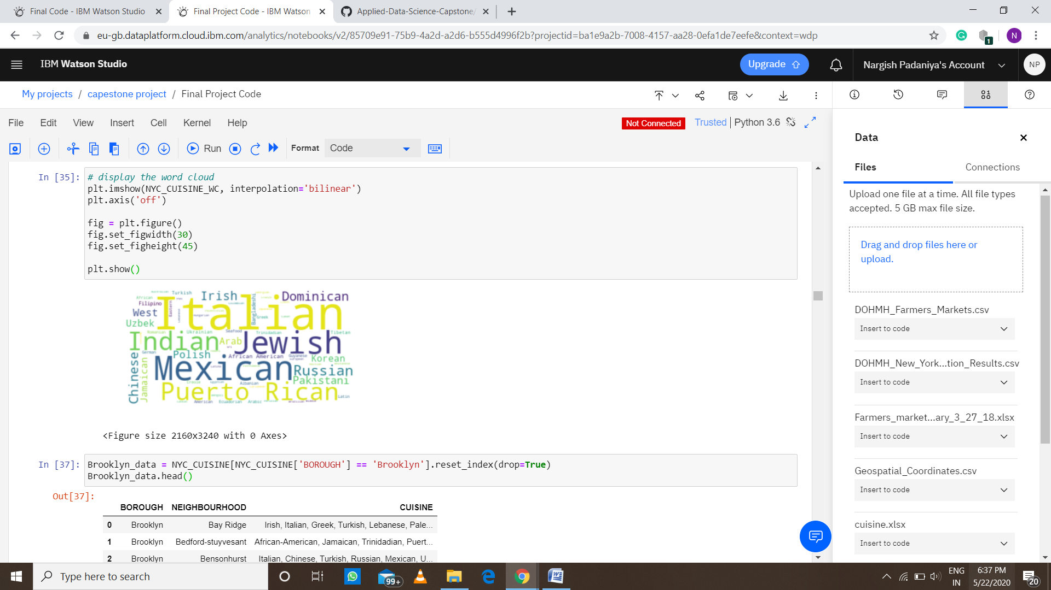
Cuisine of New York city
- This data has been manually prepared. Data is taken from Wikipedia page
https://en.wikipedia.org/wiki/Cuisine_of_New_York_City
• Data used to create word cloud.
NEW YORK CITY CUISINE : Most Preferred Food in New York City –Italian,
Puerto Rican, Mexican, Jewish, Indian, Pakistani & Irish

Slide 15
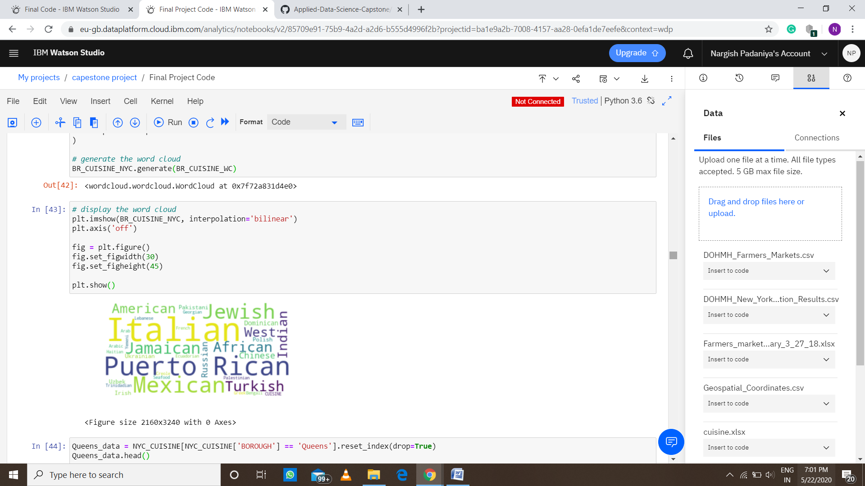
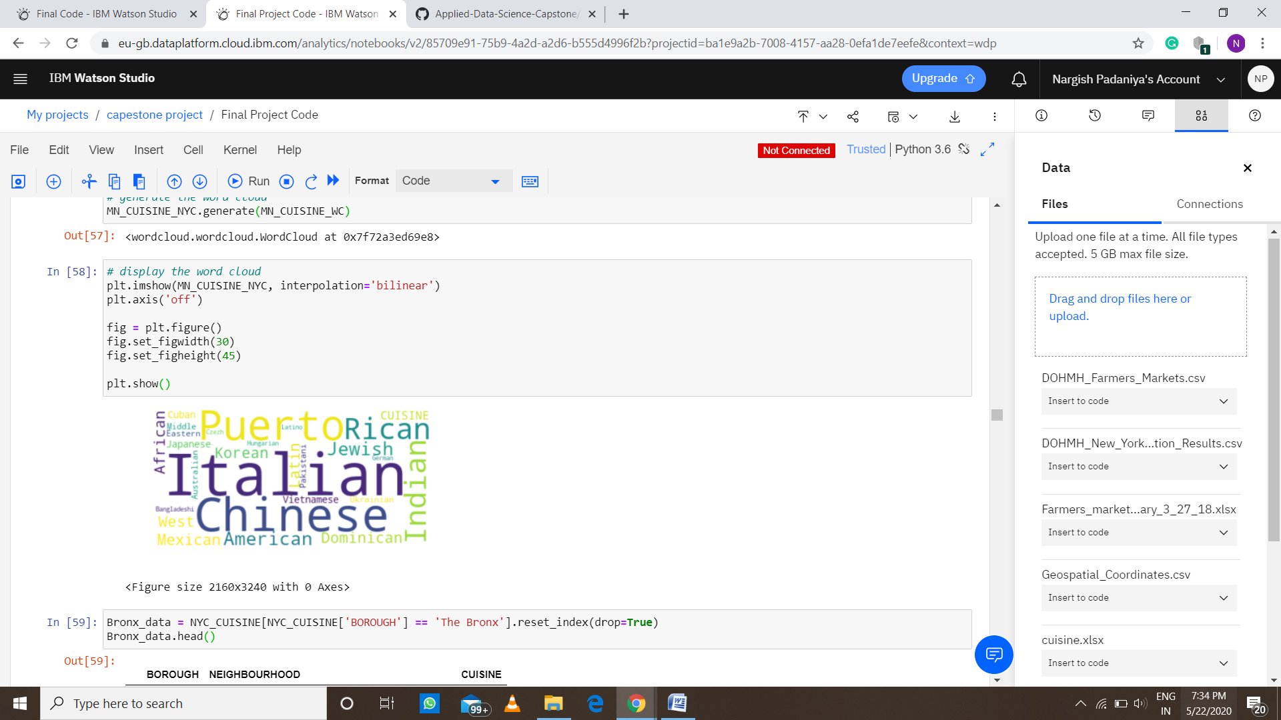
BROOKLYN CUISINE –
Most Preferred Food in Brooklyn is – Italian, Puerto Rican, Mexican and Jewish.
MANHATTAN CUISINE –
Most Preferred Food in Manhattan is - Italian, Chinese, Indian, Jewish and Puerto Rican.

Slide 16
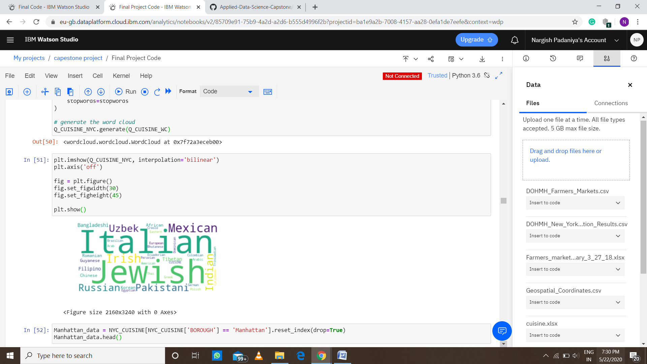
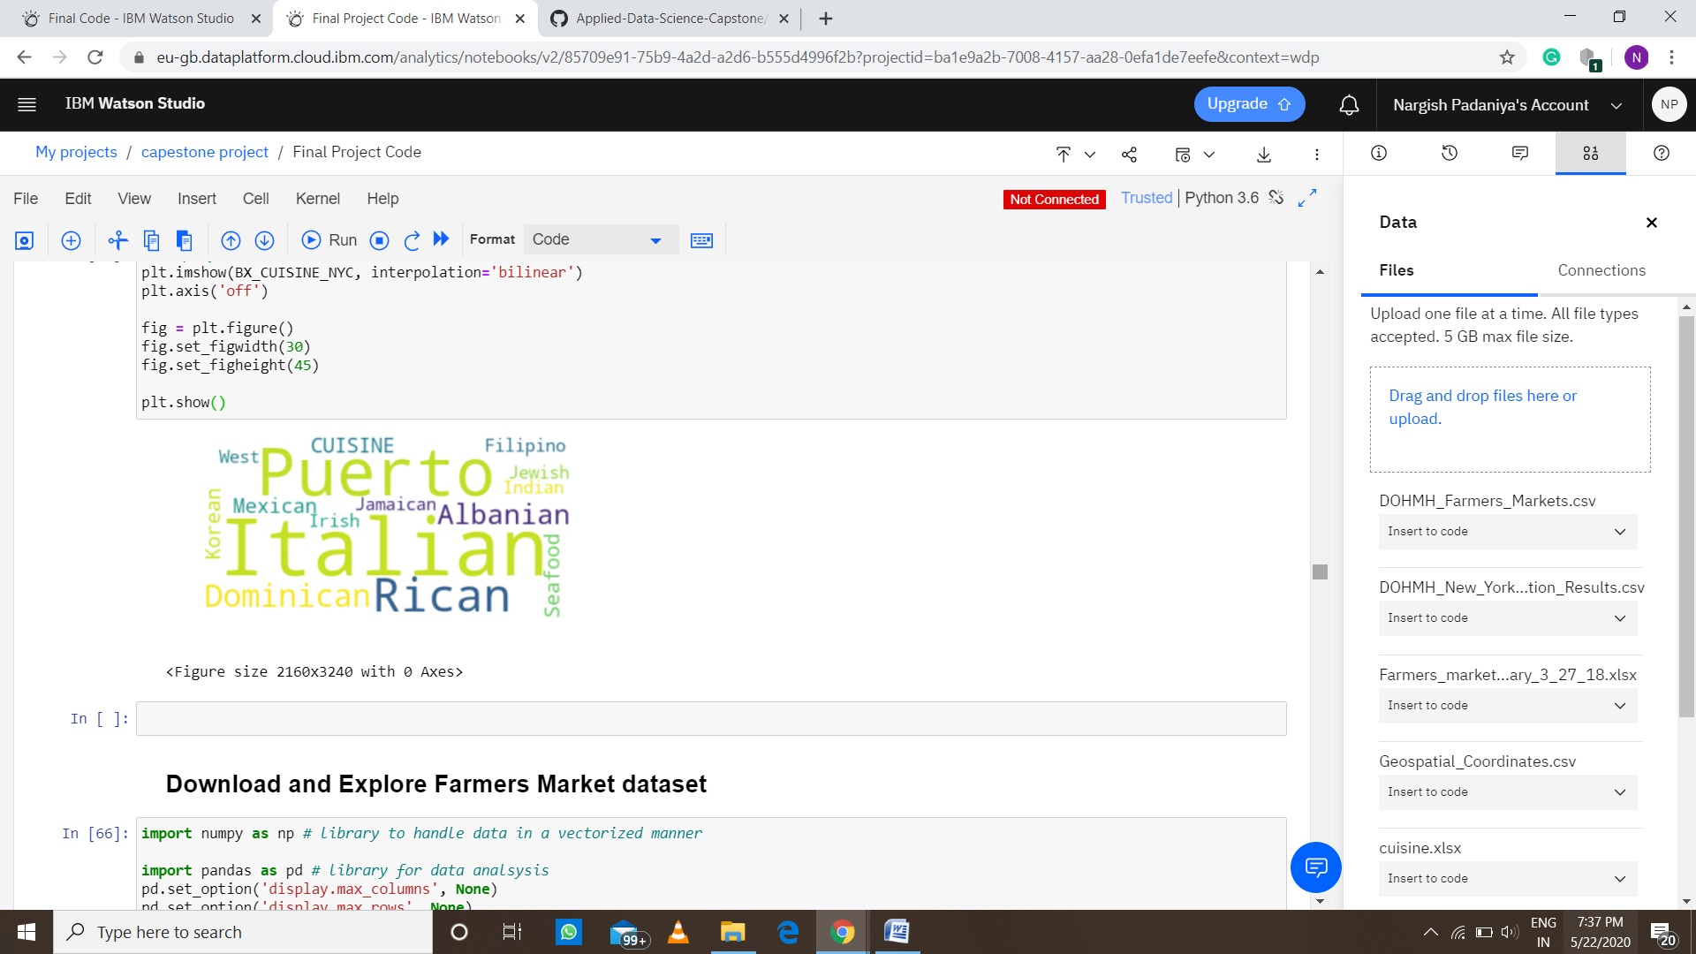
QUEENS CUISINE –
Most Preferred Food in Brooklyn is –
Italian, Irish, Mexican and Jewish.
BRONX CUISINE –
Most Preferred Food in Manhattan is - Italian, Dominican, Albanian and Puerto Rican.

Slide 17
FourSquare data of New York city
• New York city geographical coordinates data has be utilized as input for the Foursquare API, that has been leveraged to provision venues information for each neighborhood.
• We used the Foursquare API data to explore neighborhoods in New York City.
• Using the geographical coordinates of each neighborhood foursquare API calls are made to get top 200 venues in a radius of 1000 meters
PART – 1 Brooklyn and Manhattan
PART – 2 Bronx, Queens and Staten Island

Slide 18
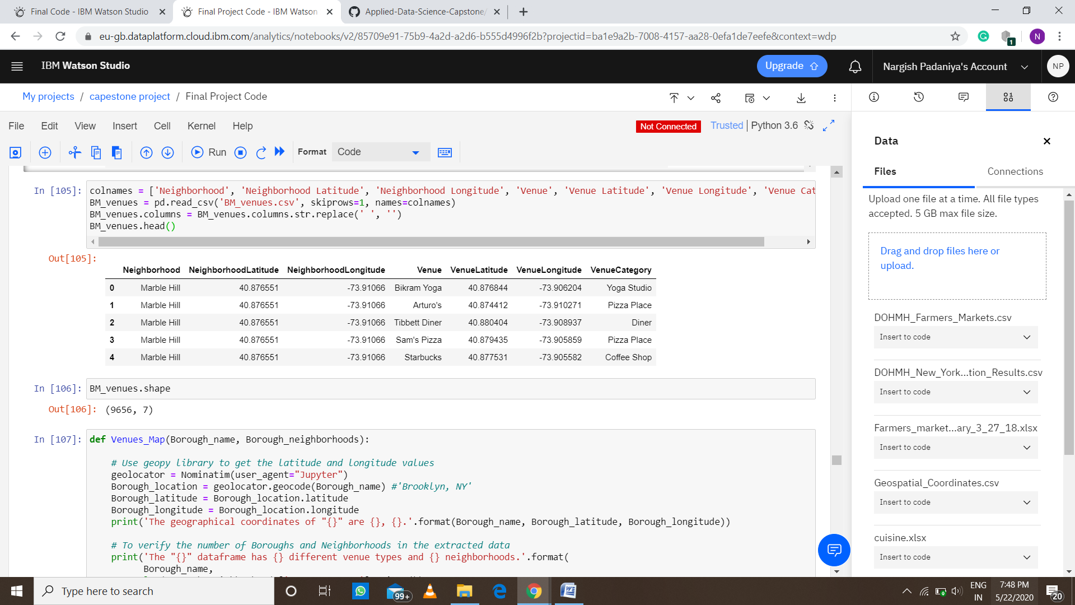
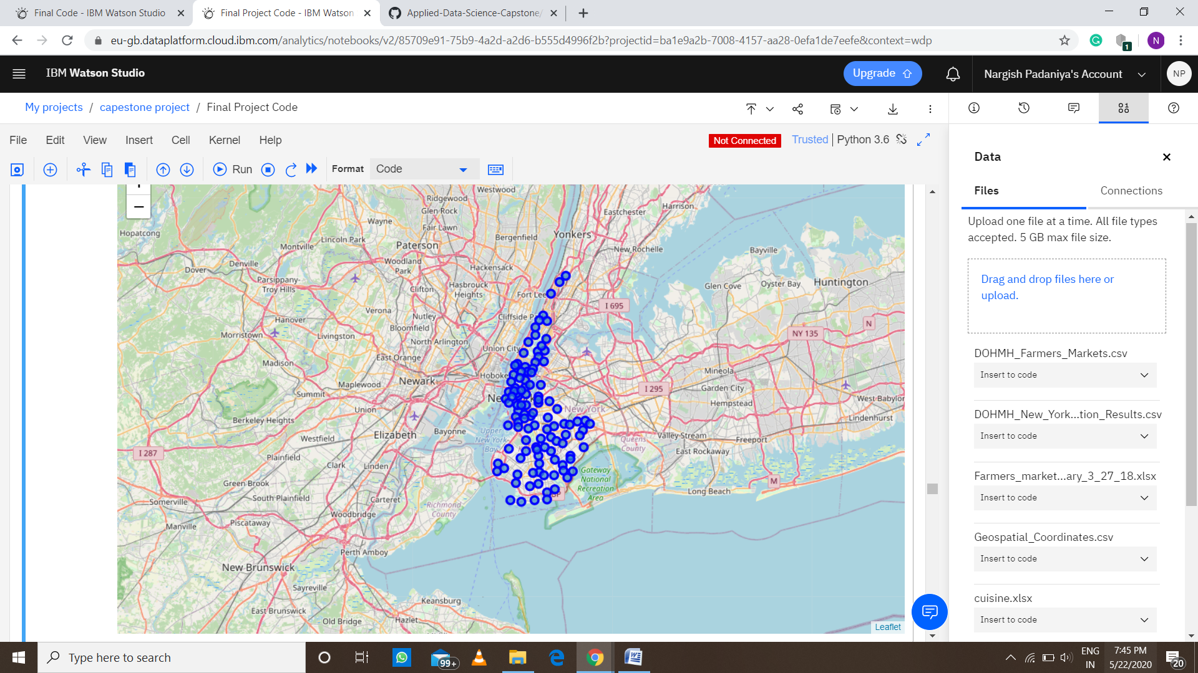
PART – 1 Brooklyn and Manhattan
Brooklyn and Manhattan Venues data
Brooklyn and Manhattan Visualization

Slide 19
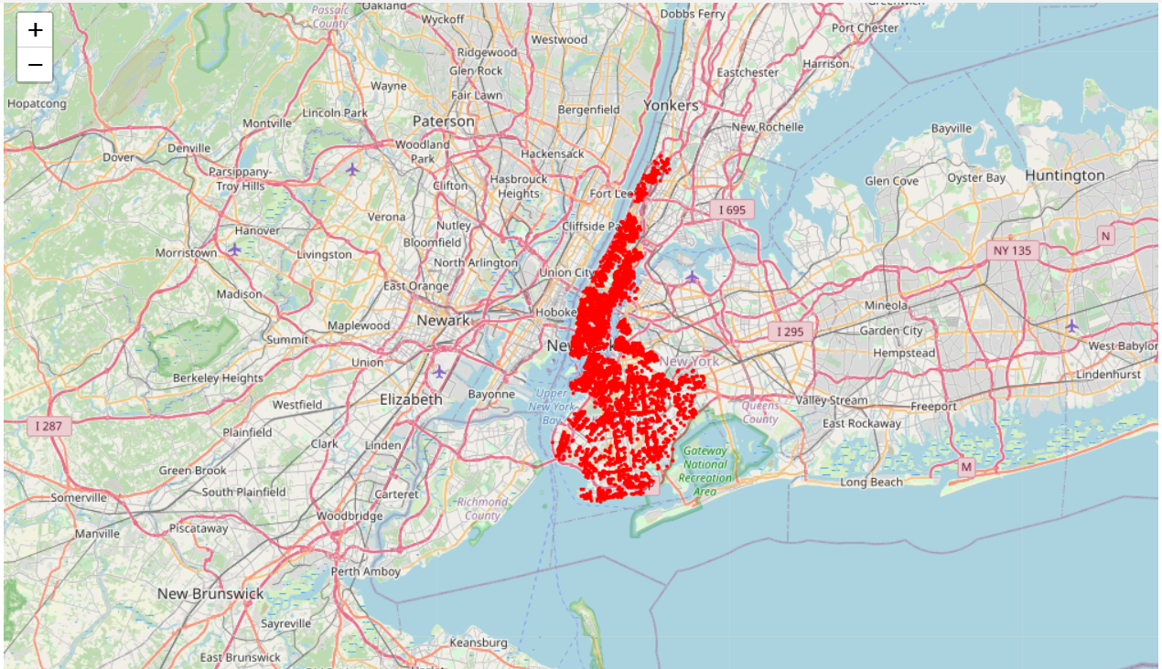
Brooklyn and Manhattan Visualization: Generated the below Brooklyn and Manhattan Venues Visualization. The “BM_venues" data frame has 9708 venues and 397 unique venue types.

Slide 20
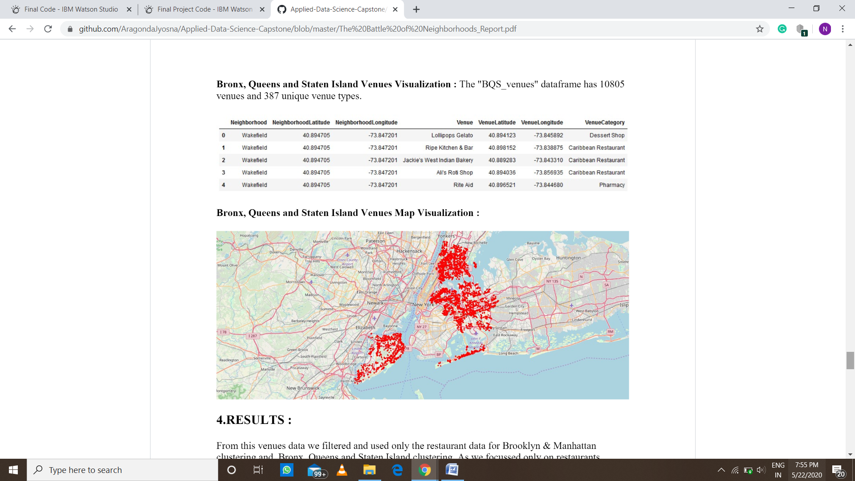
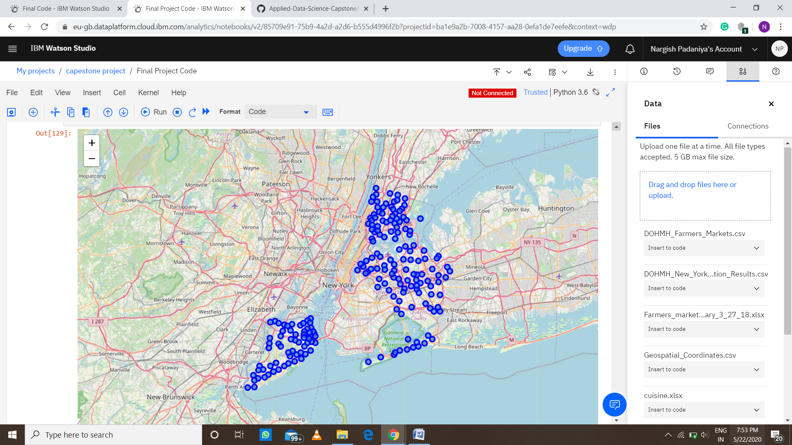
PART – 2 Bronx, Queens and Staten Island
Bronx, Queens and Staten Island Venues data
Bronx, Queens and Staten Island Visaulaization

Slide 21

Bronx, Queens and Staten Island Venues Visualization : The "BQS_venues" data frame has 10805 venues and 387 unique venue types.

Slide 22
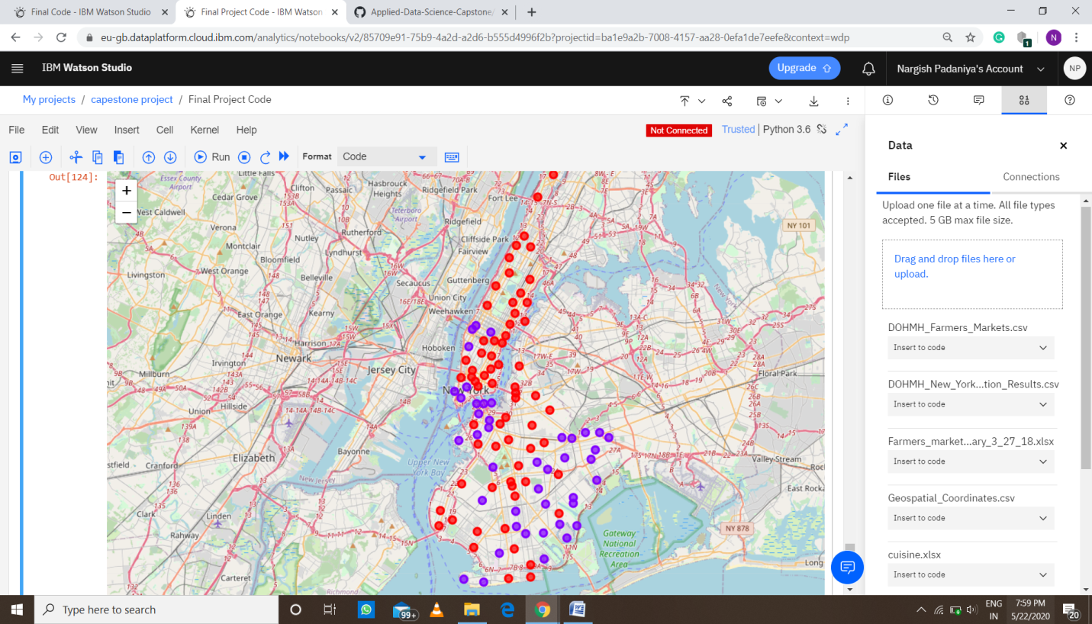
Result
PART – 1 Brooklyn and Manhattan
• Segmenting and Clustering
Neighborhoods
Cluster0 : The Total and Total Sum of cluster0 has smallest value. It shows that the market is not saturated.
- Cluster1 : The Total and Total Sum is very high. Lot of competition. Saturated neighborhoods.

Slide 23
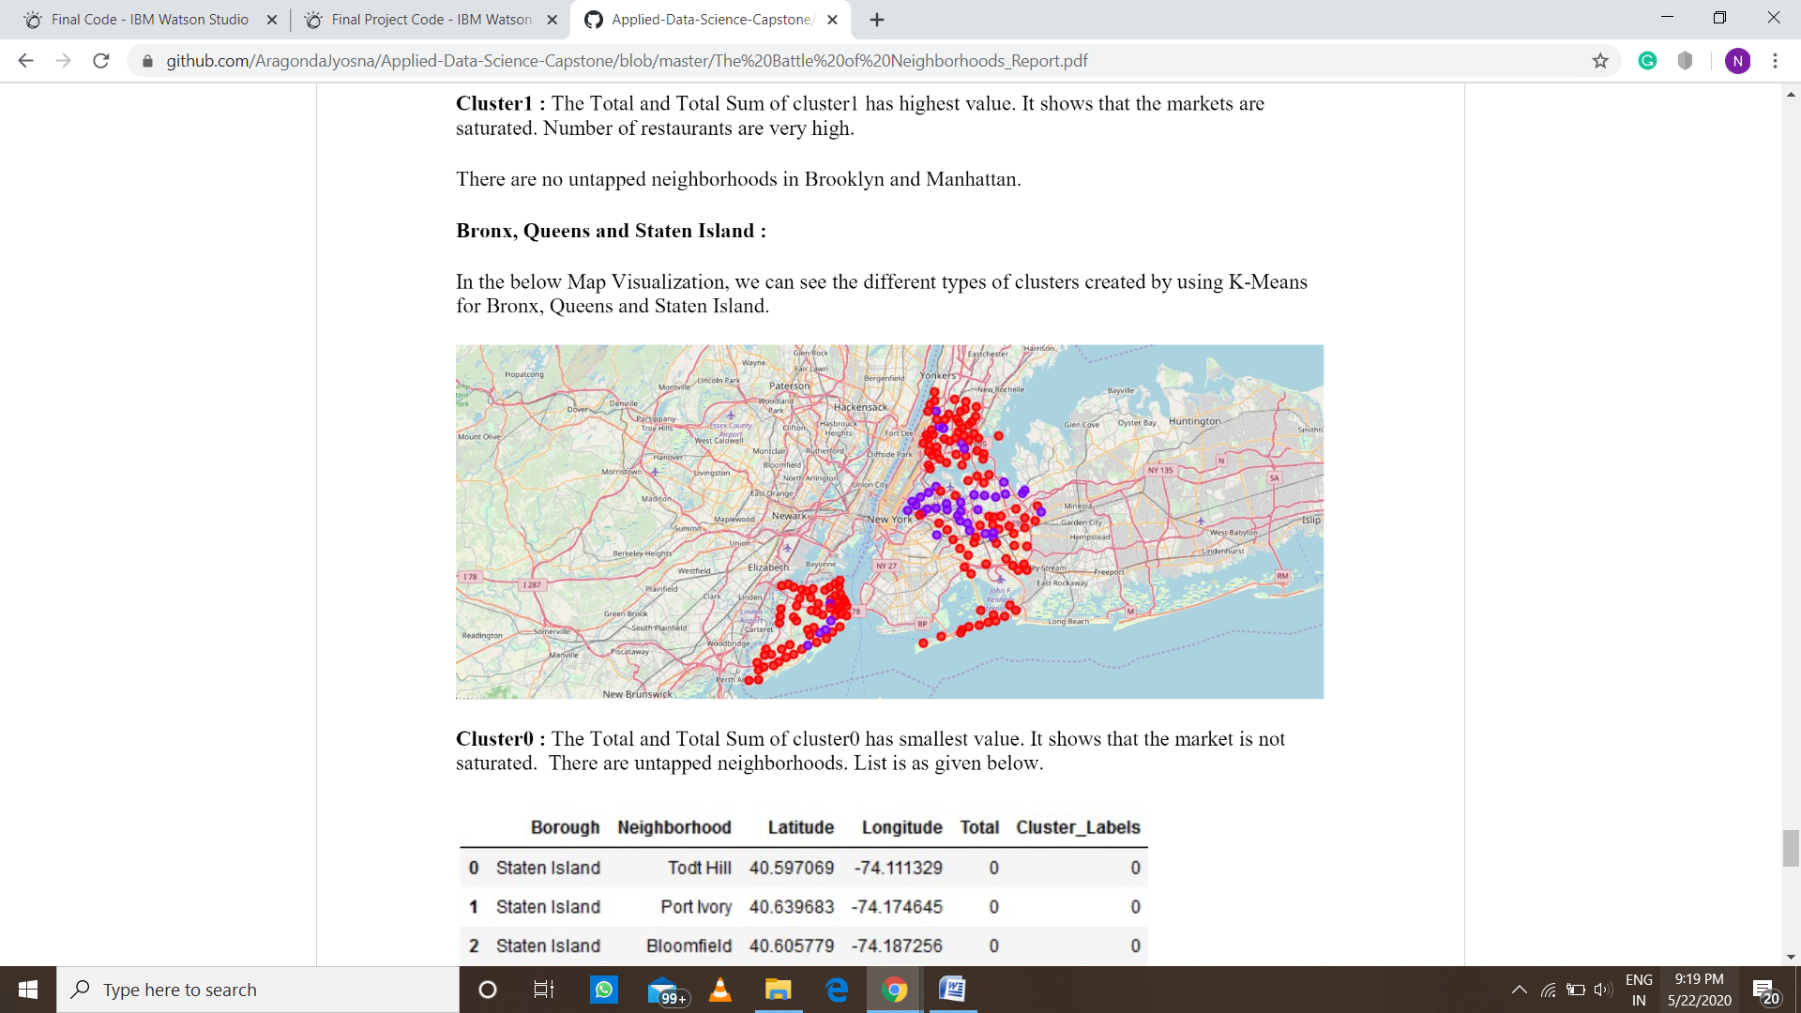
PART – 2 Bronx, Queens and Staten Island
• Segmenting and Clustering
Neighborhoods
- Cluster0 : The Total and Total Sum of cluster0 has smallest value. It shows that the market is not saturated. There
are untapped markets.
- Cluster1 : The Total and Total Sum is very high. Lot of competition. Saturated neighborhoods.

Slide 24
Discussion
The farmers market can be started in Bronx, Queens and Staten Island.
The Italian and Puerto Rican restaurants can be started in Bronx, Queens and Staten Island as there numbers of restaurants are less.
If you are risk taker then you can start a restaurant in Brooklyn and Manhattan of cuisine like Italian, Irish, Jewish. The risk is high as there are many restaurants in the same area.

Slide 25
Conclusion
This analysis is performed on limited data.
This may be right or maybe not. But if good data is available there is scope to come up with much better result
If there are lots of restaurants then probably there is lot of demand and risk can be taken by open a restaurant in an area like Brooklyn and Manhattan.
As per neighborhood and demand Italian restaurant can be much preferred.

